Slide 1
GENERATING SIMPLE GEOMETRIC SHAPES using GAN
Presented by
Divya Dharshika M P
Reg no : 962821104027
University College of Engineering Nagercoil
Computer Science and Engineering
NM id : au962821104027
dharshikadivya11@gmail.com

Slide 2
TITLE
GENERATING SIMPLE GEOMETRIC SHAPES USING GAN

Slide 3
AGENDA
Problem Statement
Project Overview
End Users
Our Solution and its Value Proposition
The Wow in Our Solution
Modelling Approach
Results
Conclusion

Slide 4
PROBLEM STATEMENT
The problem statement for generating simple geometric shapes using GANs (Generative Adversarial Networks) involves creating a model that can learn and generate realistic representations of basic geometric shapes such as squares, circles, triangles, and rectangles. This task entails training a GAN architecture with the objective of generating images that resemble these shapes, ensuring they possess attributes like symmetry, clear edges, and appropriate proportions. The goal is to produce high-quality synthetic images that closely resemble the target shapes while allowing for variations in size, rotation, and positioning. This problem statement serves as a foundational step towards more complex image generation tasks and can find applications in computer graphics, data augmentation, and generative art.

Slide 5
PROJECT OVERVIEW
1. Objective : The main goal of this project is to utilize Generative Adversarial Networks (GANs) to generate simple geometric shapes, such as circles, squares, triangles, and rectangles.
2. Methodology
- Data Collection : Gather a dataset containing examples of simple geometric shapes. This dataset will serve as the training data for the GAN.
- Model Architecture: Design and implement a GAN architecture suitable for generating the desired shapes. This will involve creating both the generator and discriminator networks.
- Training: Train the GAN using the collected dataset. The generator learns to generate realistic geometric shapes, while the discriminator distinguishes between real and generated shapes.
- Evaluation: Evaluate the performance of the trained GAN by generating samples and assessing their quality. Metrics such as visual inspection and statistical analysis can be used.
3. Implementation Steps:
- Preprocess the dataset: Resize and normalize the images of geometric shapes.
- Design the GAN architecture: Define the generator and discriminator networks using deep learning frameworks like TensorFlow or PyTorch.
- Training phase: Train the GAN on the preprocessed dataset, adjusting hyperparameters as needed.
- Evaluation phase: Generate samples using the trained GAN and assess their quality. Iterate on the model architecture and training process if necessary.

Slide 6
4. Potential Challenges:
- Generating diverse and realistic shapes.
- Mode collapse: Ensuring that the GAN does not get stuck generating only a limited set of shapes.
- Finding the right balance between generator and discriminator training to achieve convergence.
5. Expected Output:
- A trained GAN model capable of generating simple geometric shapes.
- Generated samples showcasing the diversity and quality of the generated shapes.
6. Applications:
- Art generation: Creating abstract geometric artworks.
- Data augmentation: Generating synthetic data for training machine learning models.
- Educational tools: Generating visual aids for teaching geometry concepts.
7. Future Work:
- Experiment with more complex shapes and architectures.
- Explore techniques for improving the diversity and quality of generated shapes.
- Deploy the model as part of a web application or API for generating custom shapes on demand.
Overall, this project aims to demonstrate the capabilities of GANs in generating simple geometric shapes and explore their potential applications in various domains.

Slide 7
END USERS
Graphic Designers
Game Developers
Architects & Urban planners
Educational Institutions
Artists & Creative Professionals
Manufacturers & Prototypers
Researchers & Developers

Slide 8
Our Solution and it's value proposition
Efficiency and Automation:
By harnessing the power of GANs, our solution automates the process of generating simple geometric shapes, saving time and effort compared to manual creation or design tools.
Customization and Variation:
Users can easily customize the generated shapes by adjusting parameters such as size, rotation, and position, allowing for a high degree of variation and adaptability to specific needs and preferences.
High-Quality Outputs:
The GAN model is trained on a diverse dataset of real geometric shapes, ensuring that the generated outputs exhibit high quality and fidelity, suitable for professional use in various domains.

Slide 9
The WOW in our Solution
Hyper-Realistic Outputs:
Our GAN-powered system generates geometric shapes with such precision and detail that they appear indistinguishable from real-world objects. Users are amazed by the lifelike quality of the shapes, which adds a sense and wonder to their creative endeavors.
Interactive Exploration:
We provide users with intuitive tools to interactively explore and manipulate the generated shapes in real-time. From adjusting dimensions to experimenting with textures and materials, users can unleash their imagination and witness the immediate impact of their changes, resulting in a highly engaging and immersive experience.
Dynamic Adaptability:
Our solution adapts to users' preferences and requirements, dynamically generating shapes that align
with creative vision. Whether it's generating a single shape or an entire collection, our system effortlessly adjusts to meet the user's needs, providing endless possibilities for experimentation and expression.
Future-Forward Innovation:
We stay at the forefront of technological advancements, continuously pushing the boundaries of what's possible with GANs and shape generation. By leveraging the latest research and techniques, we ensure that our solution remains at the cutting edge, inspiring users with glimpses of the future of digital creativity.

Slide 10
Modelling Approach
Define the Generator Network:
Start with a simple neural network architecture, such as a feedforward network or a convolutional neural network (CNN).
The input to the generator could be a random noise vector or a latent space vector representing the desired shape parameters (e.g., size, position, rotation).
The output should be the coordinates or parameters defining the geometric shape (e.g., vertices of a polygon, radius and center of a circle).
Define the Discriminator Network:
Similarly, design a discriminator network, which can be a CNN or a feedforward network, to discriminate between real and generated shapes.
The input to the discriminator would be the coordinates or parameters of the shapes.
Loss Functions:
Define appropriate loss functions for both the generator and the discriminator.
For the generator, use a combination of adversarial loss (encouraging the generator to produce shapes that fool the discriminator) and a shape loss.
For the discriminator, use binary cross-entropy loss to distinguish between real and generated shapes.

Slide 11
Training:
Train the GAN in a supervised manner, where the ground truth shapes are provided as part of the training data.
Generate synthetic training data by randomly sampling shape parameters and feeding them into the generator.
Train the discriminator to correctly classify real and generated shapes.
Update the generator to produce shapes that are more likely to fool the discriminator while also resembling the desired geometric shapes.
Evaluation:
Evaluate the trained model by generating new shapes and visually inspecting their quality.
Measure the similarity between the generated shapes and the desired geometric shapes using appropriate metrics (e.g., IoU for bounding boxes, distance metrics for polygons).
Iterative Refinement:
Refine the architecture and training procedure based on the evaluation results to improve the quality of generated shapes

Slide 12
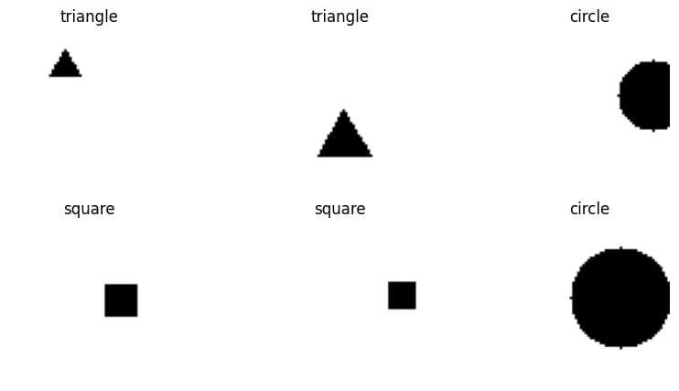
Result

Slide 13
Conclusion
In conclusion, the use of Generative Adversarial Networks (GANs) for generating simple geometric shapes presents a fascinating application of deep learning techniques. By employing a GAN architecture consisting of a generator and discriminator, we can effectively learn the underlying distribution of shape images and generate new samples that closely resemble the shapes in the dataset.
Through the systematic approach outlined above, we can develop and deploy a GAN-based system for generating simple geometric shapes.

Slide 14
